Slide 1
QF5210 GROUP PROJECT
SGP Intraday Timing Strategy
A Singapore return stream
your portfolio doesn’t already own
SGX MSCI Singapore Index Futures · November 2026
CHANG JIAYI · JI DIFEI · JOO JUNGHO · LIU MEISHAN · WANG YUTING
QF5210 · SGP Investor Pitch
1/14
Notes:
[0:00–0:20] Good morning. Today you'll hear several Singapore strategies. Ours is built to do one thing the others can't: earn returns that don't depend on the Singapore market going up. In the next eight minutes I'll show you why it deserves part of your ten thousand dollars.

Slide 2
WHY THIS STRATEGY
Most Singapore strategies sell you the same risk
Long-only books all move with the market. Owning five of them is owning one risk five times.
0.09
0.18
3%
Beta to the market
Correlation with buy & hold
Daily variance from the market
What an allocator actually lacks is a return stream that behaves differently.
OOS 2 Jan 2024 – 30 Sep 2026 · 715 days · EMA product · net of costs
QF5210 · SGP Investor Pitch
2/14
Notes:
[0:20–1:00] Here's the problem. Every long Singapore portfolio rises and falls with the market. Our strategy has a beta of 0.09 and a correlation of 0.18 with buy-and-hold; the market explains about 3 percent of its daily moves. That is exactly the gap a portfolio needs filled.

Slide 3
STRATEGY AT A GLANCE
Simple to run, transparent to audit
Instrument
SGX MSCI Singapore Index Futures (SGP) — exchange-traded, liquid
Decision
Once a day at 17:00 SGT · data ≤16:59 · fill at the close
Direction
Long or short · position sized by signal strength
Risk control
10% vol target · 1× leverage cap · exposure cuts when markets get volatile
QF5210 · SGP Investor Pitch
4/14
Notes:
[1:40–2:15] What we trade: SGP futures, one decision a day at 5 p.m., long or short. Positions are scaled to a 10 percent volatility target, so exposure falls automatically when markets get rough. Every input is time-stamped, so the whole thing can be audited day by day.

Slide 4
INVESTMENT HIGHLIGHTS
Four reasons to allocate
UNCORRELATED
PROVEN OUT OF SAMPLE
Long or short, beta 0.09.
Returns from timing, not market beta.
Sharpe 0.55 net of costs
over 715 days the model never saw.
COST-EFFICIENT
DEFENSIVE WHEN IT MATTERS
Turnover cut 61%.
Still positive at 5 bp fees.
Oct 2026, params frozen:
−3.3% while market fell 8.2%.
QF5210 · SGP Investor Pitch
3/14
Notes:
[1:00–1:40] Four reasons. It is uncorrelated. It held up on data it never saw. It survives realistic trading costs. And when the market fell in October, after we had frozen every parameter, it lost less than half as much. The next slides prove each one.

Slide 5
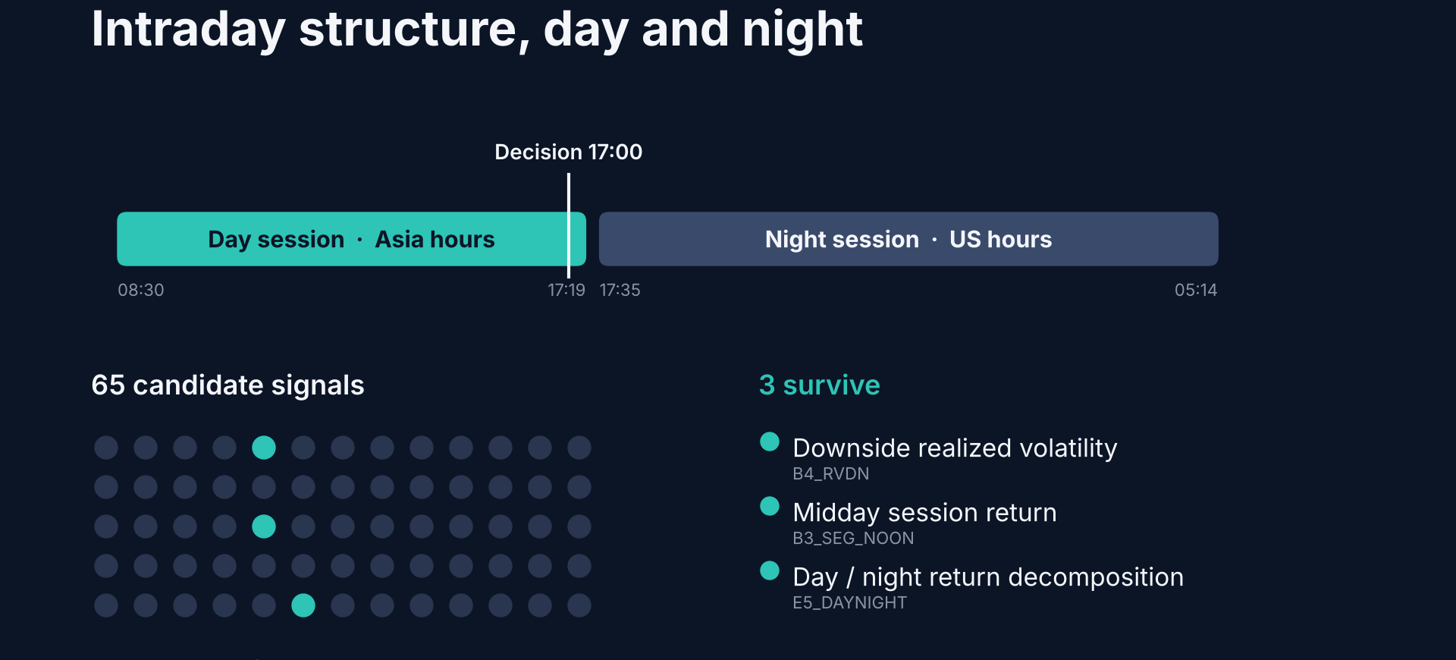
THE EDGE
Intraday structure other daily strategies cannot see
QF5210 · SGP · chart from Investor Pitch
5/14
Notes:
[2:15–2:55] The edge is intraday structure. SGP trades through the Asian day session and a night session that covers US hours. From 65 candidate signals, screened only on 2020–2022 data, three survive: downside realized volatility, the midday session return, and the split between day and night returns. These are Singapore-specific signals that daily-close strategies cannot see.

Slide 6
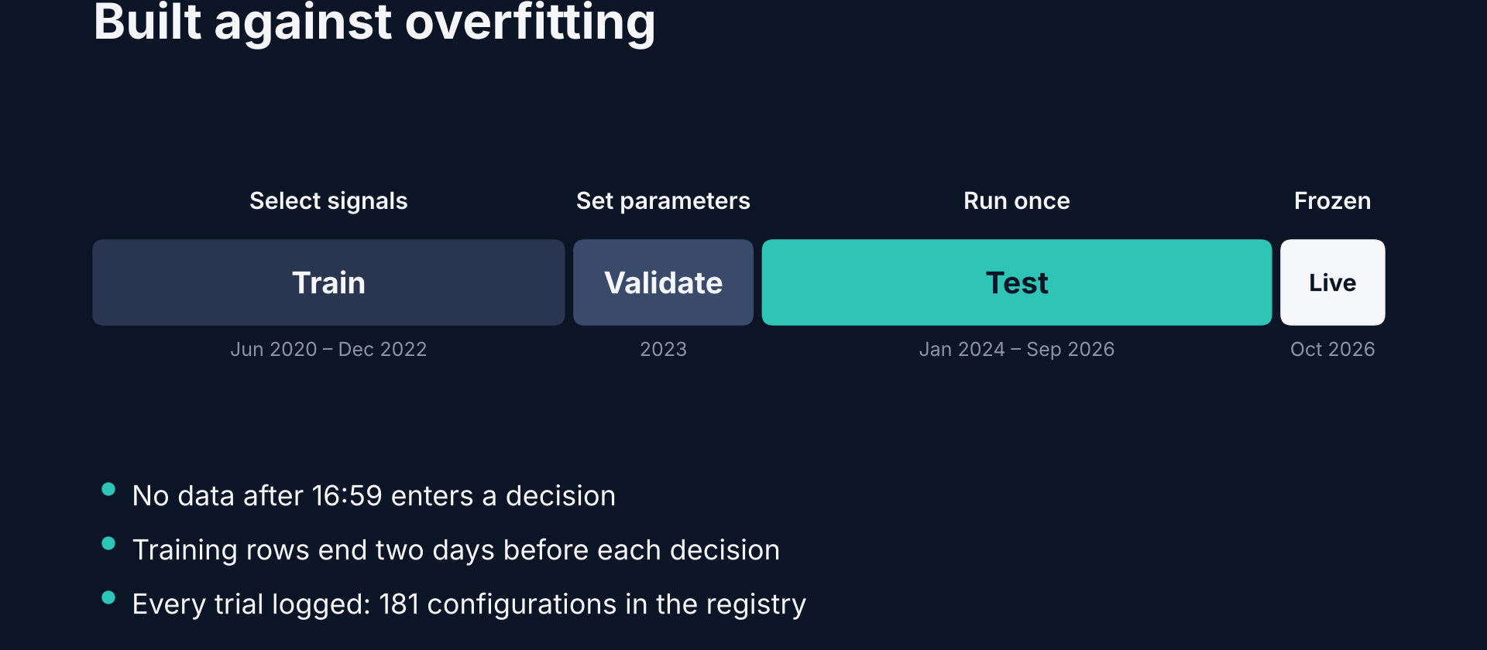
PROCESS
Built so overfitting is hard
QF5210 · SGP · chart from Investor Pitch
6/14
Notes:
[2:55–3:30] We built the process to make overfitting hard. Signals were chosen on 2020 to 2022, parameters on 2023, and the 2024–2026 test was run once. No data after 4:59 p.m. enters a decision, and we follow the exchange's historical trading hours rather than today's. Every one of the 181 configurations we tried is logged.

Slide 7
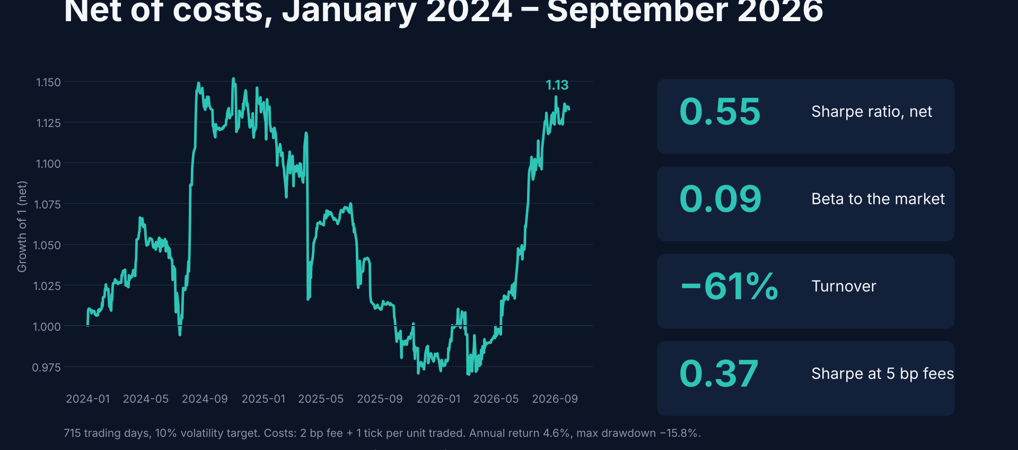
OUT-OF-SAMPLE RESULT
Sharpe 0.55 on data the model never saw
QF5210 · SGP · chart from Investor Pitch
7/14
Notes:
[3:30–4:10] The result: out of sample, net of costs, a Sharpe of 0.55 over 715 trading days, with a market beta of 0.09. Annual return is 4.6 percent at a 10 percent volatility target — the return is a dial, as I'll show later. The quality metric is the Sharpe, and it was earned on data the model never saw.

Slide 8
COST EFFICIENCY
Built to survive real trading costs
Many backtests die when you charge for trading — this one does not
−61%
0.37
Turnover 106× → 41× / year
Sharpe at 5 bp fees
from EMA signal smoothing
2.5× our base-case fee assumption
Raw pre-registered model: high turnover, edge disappears after costs.
Smoothed product: still positive when the raw version goes negative.
QF5210 · SGP Investor Pitch
8/14
Notes:
[4:10–4:45] Many backtests look good until you charge for trading. The raw version of our model traded 106 times its capital a year and its edge disappeared after costs. Smoothing the signal cut turnover by 61 percent. At 5 basis points per trade, the raw model goes negative; ours still delivers 0.37.

Slide 9
DEFENSIVE PROFILE
When the market falls, the strategy holds up
What a diversifier is supposed to do
−0.2%
7 of 10
≈ 0%
Avg strategy month
Down months beating market
Avg on worst 10% days
when market fell (−1.3%)
5 of 10 made money
market −1.9% those days
10 of 33 hist-test months had a negative market return.
Fair note: April 2025 (tariff shock) was our worst month too.
QF5210 · SGP Investor Pitch
9/14
Notes:
[4:45–5:25] This is what a diversifier should do. In the ten months the market fell, the strategy averaged minus 0.2 percent against the market's minus 1.3; it beat the market in seven of them and made money in five. On the market's worst days it was flat on average. To be fair, April 2025, the tariff shock, was a bad month for us too.

Slide 10
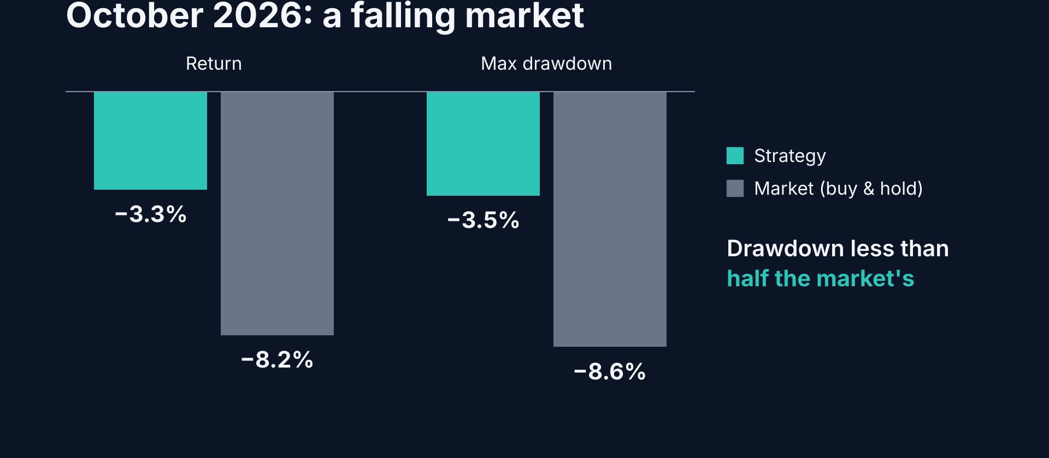
THE REAL TEST
Parameters frozen — then the market fell
QF5210 · SGP · chart from Investor Pitch
10/14
Notes:
[5:25–6:00] Then the real test. We froze every parameter before October. The market fell 8.2 percent in October; the strategy lost 3.3, with a maximum drawdown of 3.5 percent against the market's 8.6. Twenty-one days prove nothing statistically, but it is the behaviour the backtest predicted.

Slide 11
PORTFOLIO FIT
Add it to a long Singapore book — risk falls
30% sleeve: Sharpe 1.39→1.42 · max DD −17.8%→−14.5% · vol 17.3%→12.8%
Weight in our sleeve
Portfolio Sharpe
Max DD
Ann. vol
0% (pure BH)
+1.39
−17.8%
17.3%
20% sleeve
+1.42
−15.6%
~14.7%
30% sleeve ★
+1.42
−14.5%
12.8%
40% sleeve
+1.42
−13.4%
~12.0%
Hist test was a strong Singapore bull market — the hardest setting for a diversifier to shine.
QF5210 · SGP Investor Pitch
11/14
Notes:
[6:00–6:40] Here is how it works inside a portfolio. Put 30 percent in our strategy and 70 in Singapore buy-and-hold: the Sharpe ratio goes up slightly, and the maximum drawdown falls from 17.8 to 14.5 percent, with a quarter less volatility. And remember, that test period was a strong bull market — the hardest environment for a diversifier to shine.

Slide 12
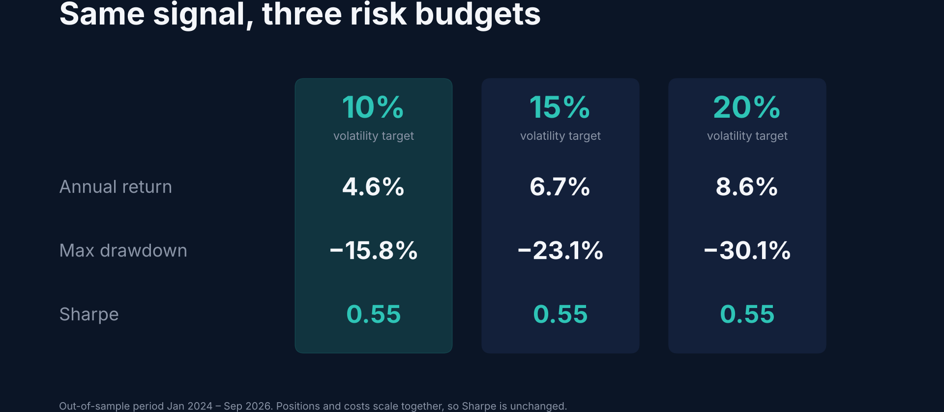
RISK IS A DIAL
Same signal — you choose the risk budget
QF5210 · SGP · chart from Investor Pitch
12/14
Notes:
[6:40–7:00] And if you want more return, risk is a dial. The same signal at a 15 or 20 percent volatility target delivers 6.7 or 8.6 percent a year, with the same Sharpe. You choose the risk; the signal stays the same.

Slide 13
RISKS AND HOW WE MANAGE THEM
What could go wrong — and what we do
Risk
What we see
How we handle it
Early evidence
Not significant after 181-trial DSR
Frozen params · publish daily positions
DSR p = 0.70 (EMA)
Losing years
2025 negative (April tariff shock)
10% vol cap · MDD −15.8% vs mkt −17.8%
Single instrument
One futures contract
Designed as a sleeve, not a standalone book
Costs / rolls
Linear costs; roll not separate
Turnover −61% · still + at 5 bp
QF5210 · SGP Investor Pitch
13/14
Notes:
[7:00–7:30] We'll be upfront about the risks. The evidence is early — after correcting for every trial we ran, it is not yet statistically significant, which is why we froze the model and will keep publishing. 2025 was a losing year. And it is one contract, so it belongs next to your other holdings, not instead of them.

Slide 14
THE ASK
30% of your $10,000
A $3,000 diversifying sleeve next to your Singapore long positions
DIFFERENT
ROBUST
ACCOUNTABLE
Beta 0.09
Sharpe 0.55
Frozen
The return stream
other picks don’t give you
OOS · positive even
at 5 bp fees
Daily positions
published through Nov
QF5210 · SGP Investor Pitch
14/14
Notes:
[7:30–8:00] So our ask is simple: put 30 percent — three thousand dollars — into our strategy as the diversifying part of your portfolio. It is different from everything else you'll see, it is robust to costs, and we will stay accountable by publishing our positions every day. Thank you — happy to take questions.

Slide 15
QF5210 · SGP
Thank you
Questions?
QF5210 · SGP Daily Timing
11/11
Notes:
~10s. Thank you / questions.

